Slide 1
Case Study : Paytm (Team – 4)

Slide 2
Agenda
About Paytm
Before AWS v/s After AWS
AWS Services used by Paytm
Why Paytm Chose AWS
Summary

Slide 3

About Paytm
Paytm is the consumer brand of India’s leading mobile internet company, One97 Communications. The brand is one of India’s largest financial services companies, offering full-stack payments and financial solutions to consumers, offline merchants, and online platforms. Today, the company serves millions of merchants and customers on its platform in India.
Millions of people across India rely on Paytm every day to manage their finances online and pay for everything from groceries to utilities to movie tickets. Paytm—which supports over 20 million merchants and business—is the largest digital payments, commerce, and financial services platform in India, used by more than 300 million Indians.

Slide 4
Challenges faced by Paytm before AWS
Scalability Challenges:
Limited Capacity
Resource Allocation
Geographical Constraints:
Limited Geographic Reach
Infrastructure Maintenance:
Resource and Time Intensive
Innovation and Time-to-market
Slow Deployment Cycles

Slide 5
Before and After AWS
The following table showcases the problems faced by Paytm and how they were overcome using AWS
Before AWS | After AWS
Limited Scalability | Offered Scalability and Flexibility
Regional Limitation | Global Reach
Resource Constraints | Innovation and time-to-market
Low Profit | Cost effective

Slide 6
Disadvantages of AWS
Cost Management Complexity:
While the pay-as-you-go model can be cost-effective, managing costs in a complex cloud environment can be challenging
Vendor Lock-In
Dependence on a specific cloud provider like AWS can lead to vendor lock-in. Transitioning to another provider may be complex and costly
Potential Downtime
While AWS aims for high availability, no service can guarantee zero downtime.
Learning Curve
Transitioning to a cloud platform may require training for the IT team to effectively manage and optimize resources.
Data Security Concerns
Although AWS provides robust security features, concerns may arise regarding the security of sensitive data stored in the cloud.

Slide 7
AWS Services Used by Paytm

Slide 8
AWS Services
Amazon EC2 (Elastic Compute Cloud)
For scalable and resizable compute capacity, allowing Paytm to run applications efficiently.
Amazon S3 (Simple Storage Service)
A scalable object storage service used for storing and retrieving data. Paytm may use this for storing images, documents, and other files.
Amazon RDS (Relational Database Service)
A managed database service that simplifies database setup and maintenance. Paytm might leverage this service for relational databases.
Amazon CloudFront
A content delivery network (CDN) service for fast and secure delivery of data and applications. Paytm could use this to deliver content to users with lower latency.

Slide 9
AWS Services
Amazon EMR
Amazon EMR is the industry-leading cloud big data platform for processing vast amounts of data using open source tools such as Apache Spark, Apache Hive, Apache HBase, Apache Flink, Apache Hudi, and Presto.
AWS Key Management Service (KMS)
For managing cryptographic keys for secure data encryption. Paytm could use this service to enhance data security.
Amazon SageMaker
A fully managed service for building, training, and deploying machine learning models. Paytm might utilize this for various data analytics and machine learning applications.

Slide 10
AWS Services
Amazon Virtual Private Cloud (VPC)
Amazon Virtual Private Cloud (VPC) gives you complete control over your virtual networking environment, including resource placement, connectivity, and security.
Amazon Launch Wizard for SAP
AWS Launch Wizard offers a guided way of sizing, configuring, and deploying AWS resources for third party applications, such as Microsoft SQL Server Always On and HANA based SAP systems, without the need to manually identify and provision individual AWS resources.

Slide 11

Why Paytm Chose AWS
Reduced infrastructure management and processing incidents by 70 percent
Streamlined data processing time for majority workloads by 98 percent
Improved data availability by 30 percent
Reduced data infrastructure cost by 30 percent

Slide 12

Vision of Paytm
By the bank’s estimates, this will increase daily average transactions on its platform from 1.8 million to 2.7 million. With it now running fully in the AWS Cloud, PPBL is ready to further ramp up operations, facilitate business growth, and stay ahead of other payments banks in the Indian market.

Slide 13
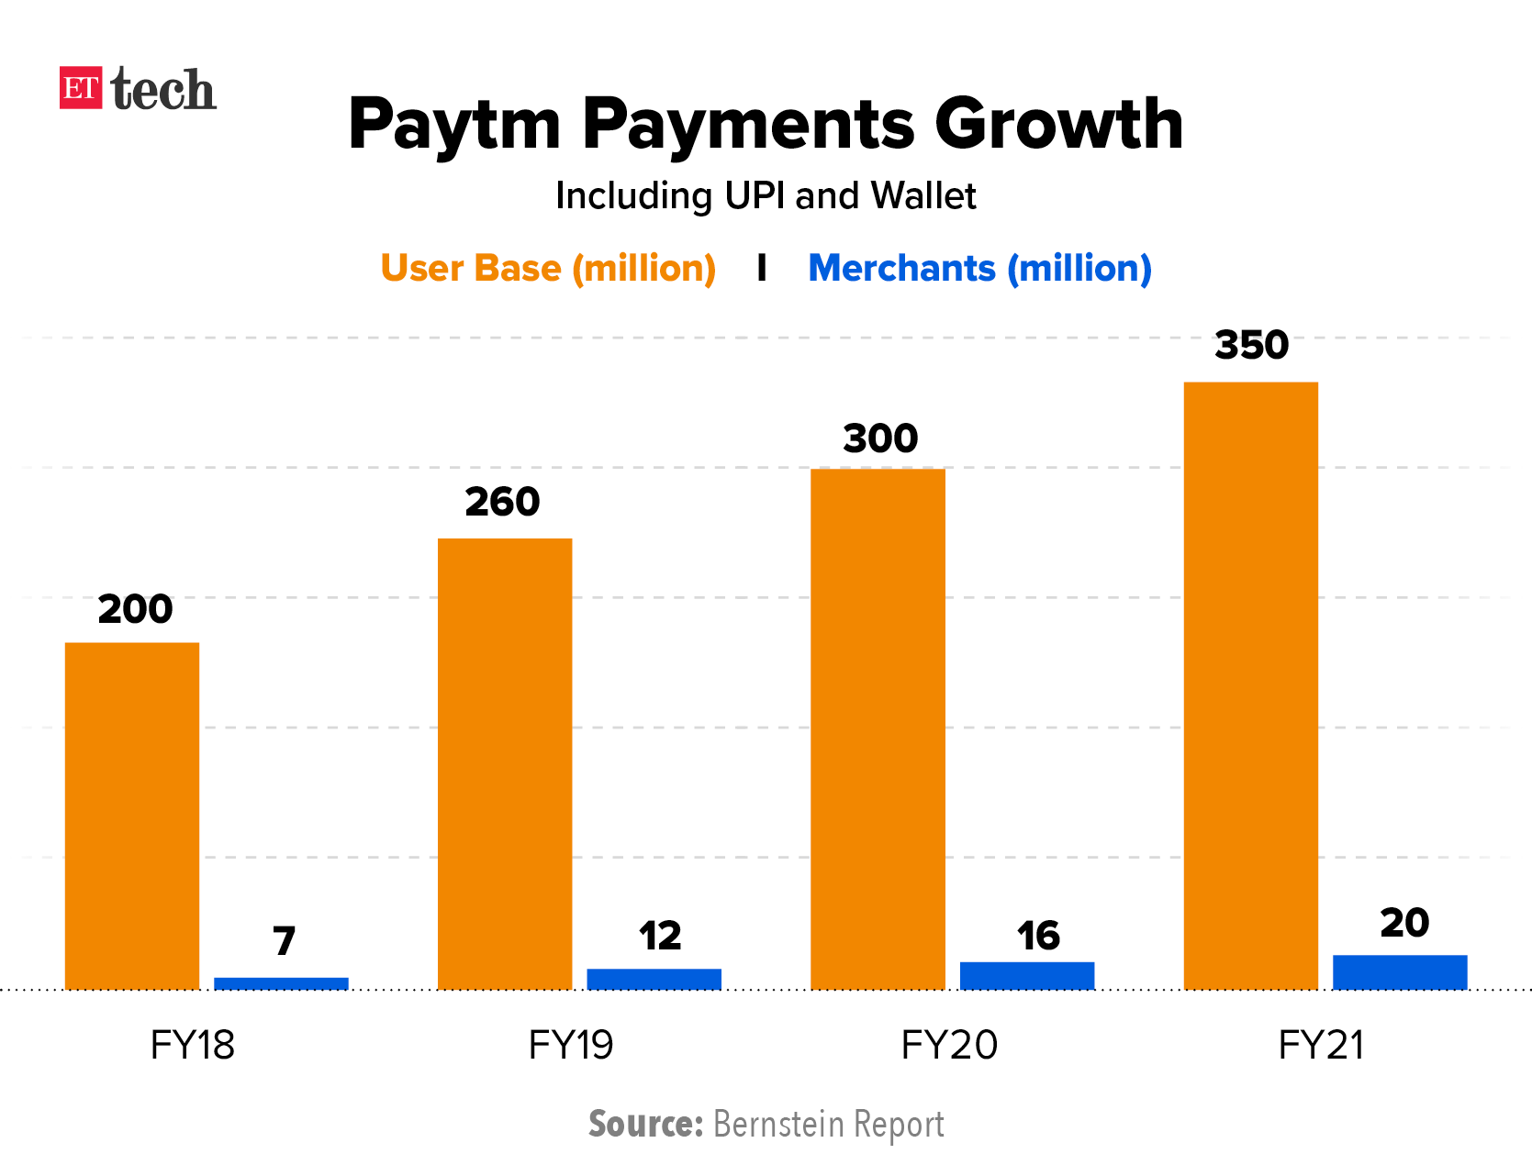

Slide 14
Summary
In summary, Paytm's journey from a mobile recharge platform to a multifaceted fintech giant has been supported by AWS's robust and scalable infrastructure. The strategic use of AWS services has likely played a crucial role in enabling Paytm to provide reliable and innovative digital financial services to millions of users in India and beyond.

Slide 15
Thank you
Adil Shaikh
Pratham Shah
Shruti Shukla
Adam Afridi

